Slide 1
Address Resolution Protocol Forensics
Traffic files: ARP_spoofing
Notes:
https://www.youtube.com/watch?v=6G3qm60dfA8&ab_channel=PrashantThombre

Slide 2
Overview
ARP introduction
APR protocol
ARP tables
ARP table demo
Capture ARP traffic demo
ARP poisoning
Capture ARP poisoning evidence
Analysis evidence

Slide 3
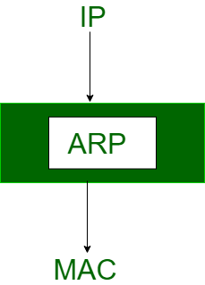
Address Resolution Protocol (ARP)
Motivation: When a device on a network wants to send data to another device, it needs to know the Media Access Control (MAC) address of the recipient. However, devices only know the IP address of other devices.
Approach: ARP protocol is used to map a network address (such as an IP address) to a physical address (such as a MAC address) on a local network.

Slide 4
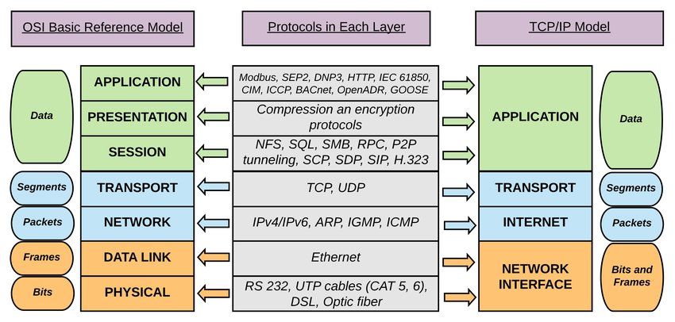

Ping uses both protocols

Slide 5
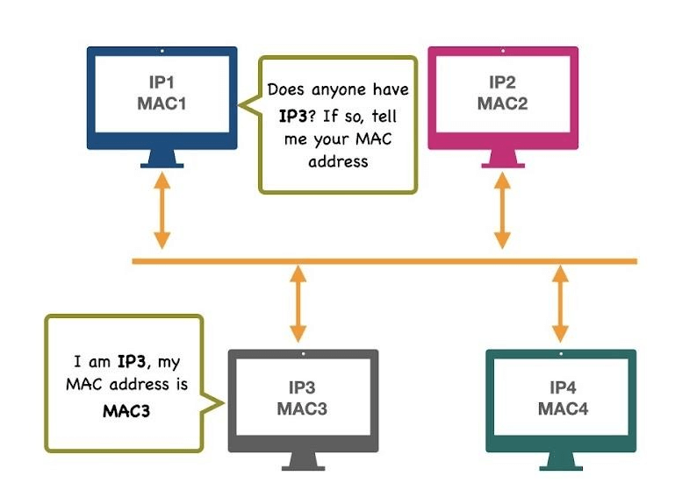
How ARP Works
Device A (with IP1, MAC 1) wants to send data to Device B (with IP3, MAC 3) on the same network.
Device A sends an ARP broadcast request message to discover the physical address of Device B.
Device B responds with its physical address, and Device A can use this information to send the data to Device B

Slide 6
What is ARP table (ARP cache)
A table used by a computer or network device to store mappings between IP addresses and MAC addresses on a local network.
One table for each device
ARP table allows devices to communicate with each other efficiently on a local network
without the need for manual configuration of MAC addresses.
ARP tables are also dynamic
they can change over time as devices join or leave the network.
Neighbor IP | Neighbor MAC | Expire
192.168.1.1 | 00:1A:4F:62:7E:8D | 2m20s
192.168.1.25 | 08:21:58:BE:A4:F2 | 3m23s
A sample ARP table of a device in LAN

Slide 7
Importance of ARP Protocol/ARP table
ARP is a critical protocol for the proper functioning of local area networks (LANs).
Without ARP, devices on a network would not be able to communicate with each other properly.
Understanding ARP is important for network administrators and anyone who works with computer networks.

Slide 8

ARP tables demo
Create a working directory
Notes:
sudo apt install python3-scapy
sudo apt install python3-pywin32

Slide 9
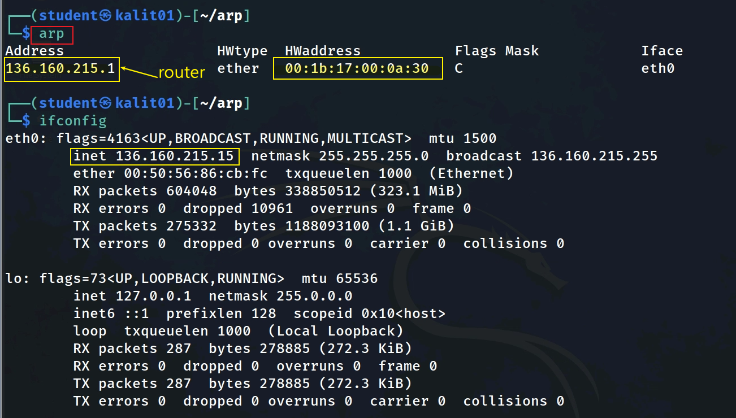
address was dynamically learned and is considered complete.
type of hardware address
Remember the Mac address (:fc), we use it later

Slide 10
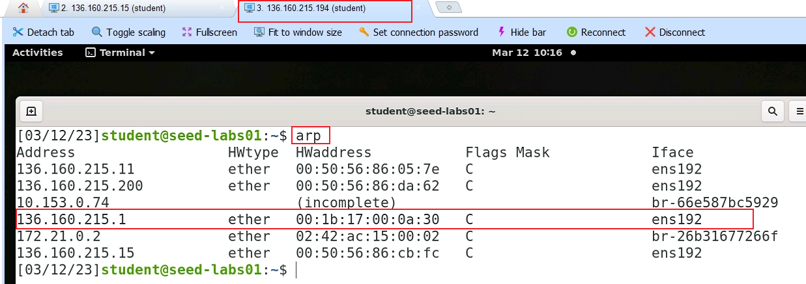
Every device has an ARP table
Show ARP table of another device in LAN

Slide 11
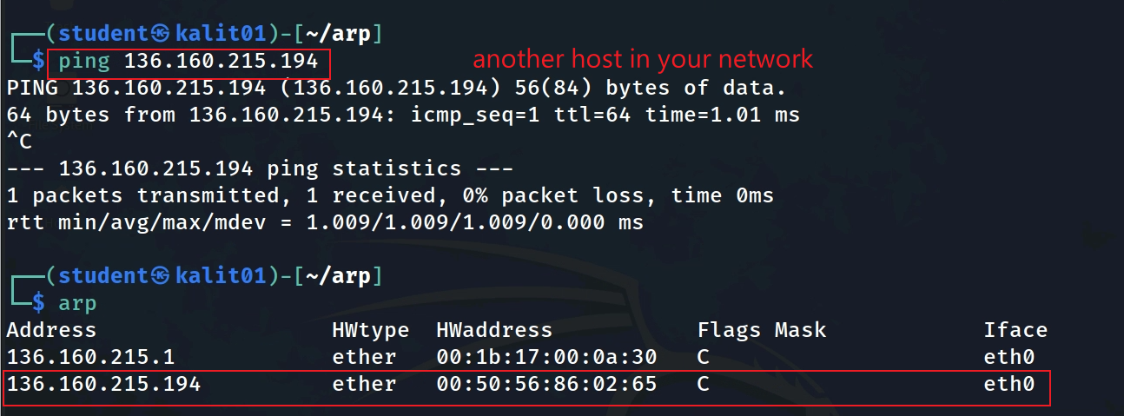


Manipulate ARP table entry
Add an entry to an ARP table using Ping
Assume we have another running machine in our network (LAN)
ping uses ARP protocol to find the target’s machine mac address
the new entry will be added to the ARP table

Slide 12




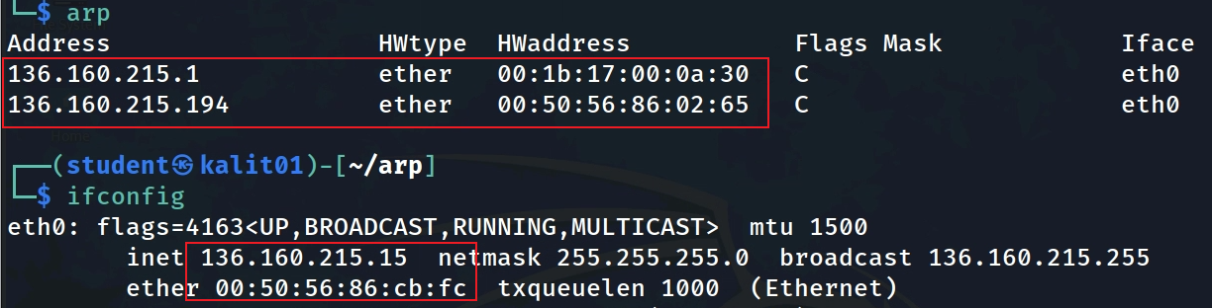





Gateway IP | Gateway Mac
Victim IP | Victim Mac
Sample ARP tables
Kali
Victim IP | Victim Mac
Gateway IP | Gateway Mac

Slide 13
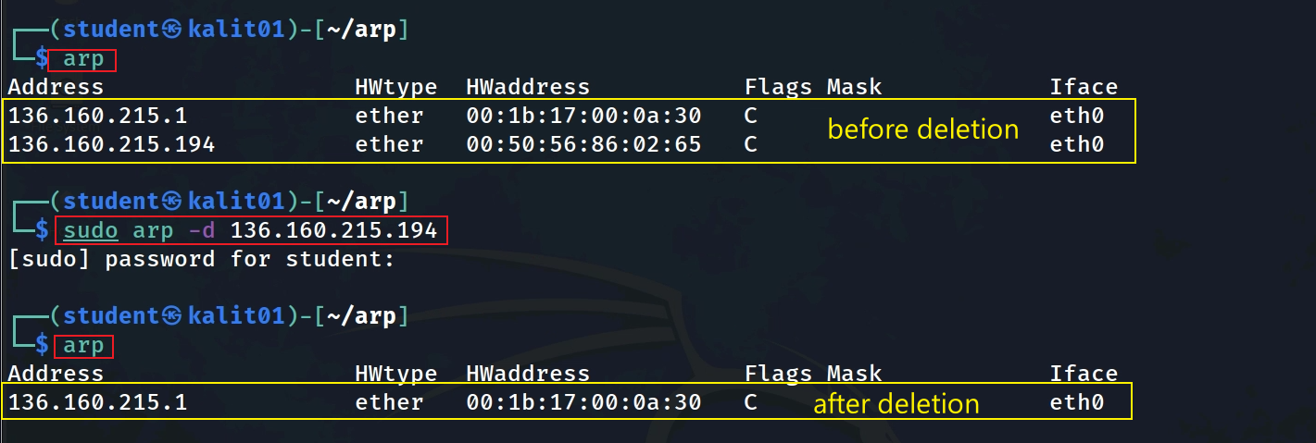
Delete an ARP entry in Kali ARP table
Notes:
https://www.thepythoncode.com/article/building-arp-spoofer-using-scapy
https://www.thepythoncode.com/article/make-dns-spoof-python
https://www.geeksforgeeks.org/python-how-to-create-an-arp-spoofer-using-scapy/

Slide 14
Capture ARP traffic

Slide 15
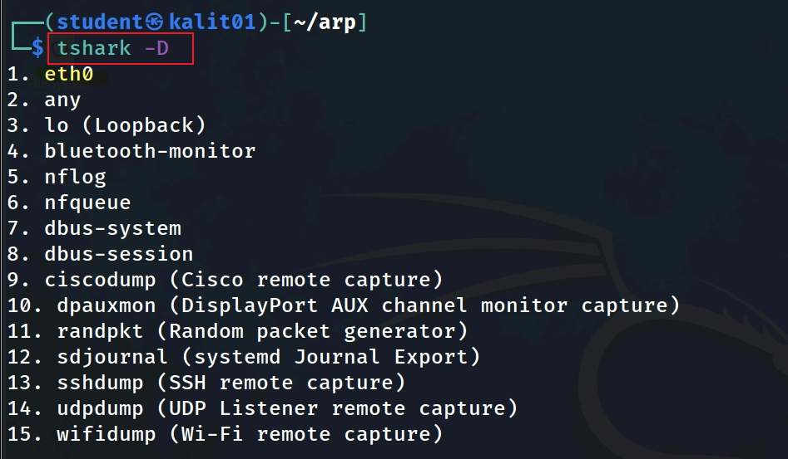
Check network interface using tshark
We will use eth0

Slide 16
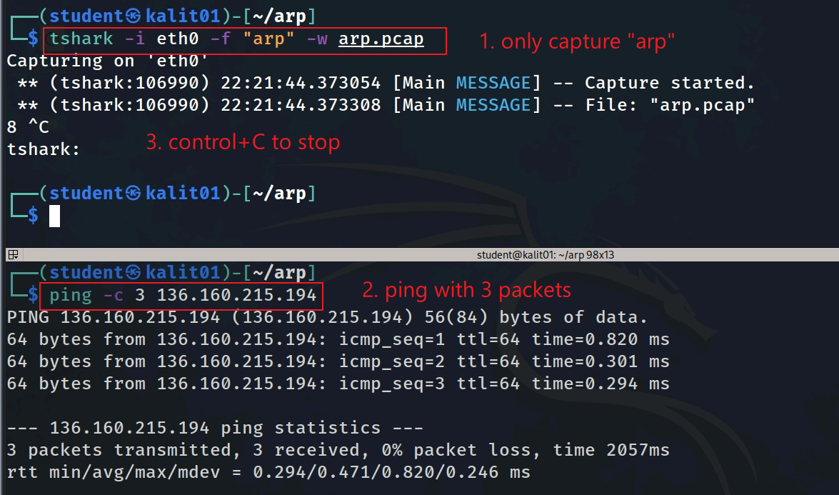

Slide 17
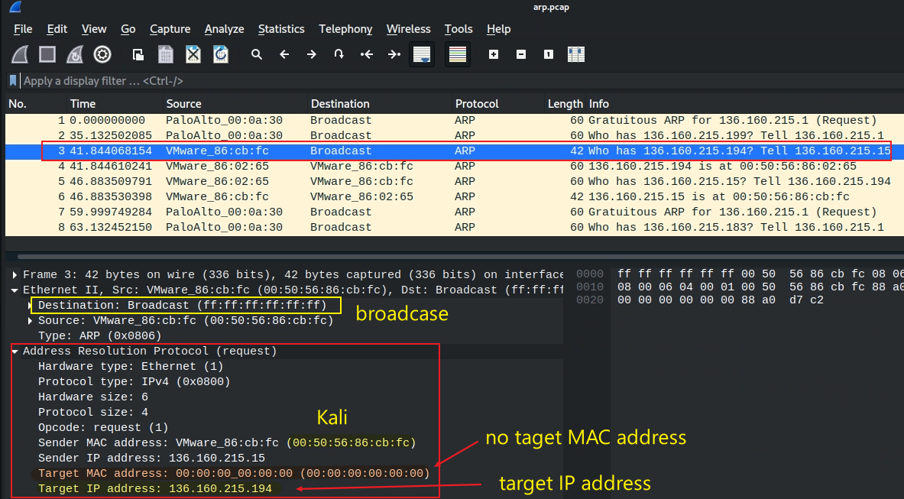


ARP request message
wireshark arp.pcap
wget https:/raw.githubusercontent.com/frankwxu/digital-forensics-lab/main/Networking_Forensics/lab_files/ARP_spoofing/arp.pcap

Slide 18
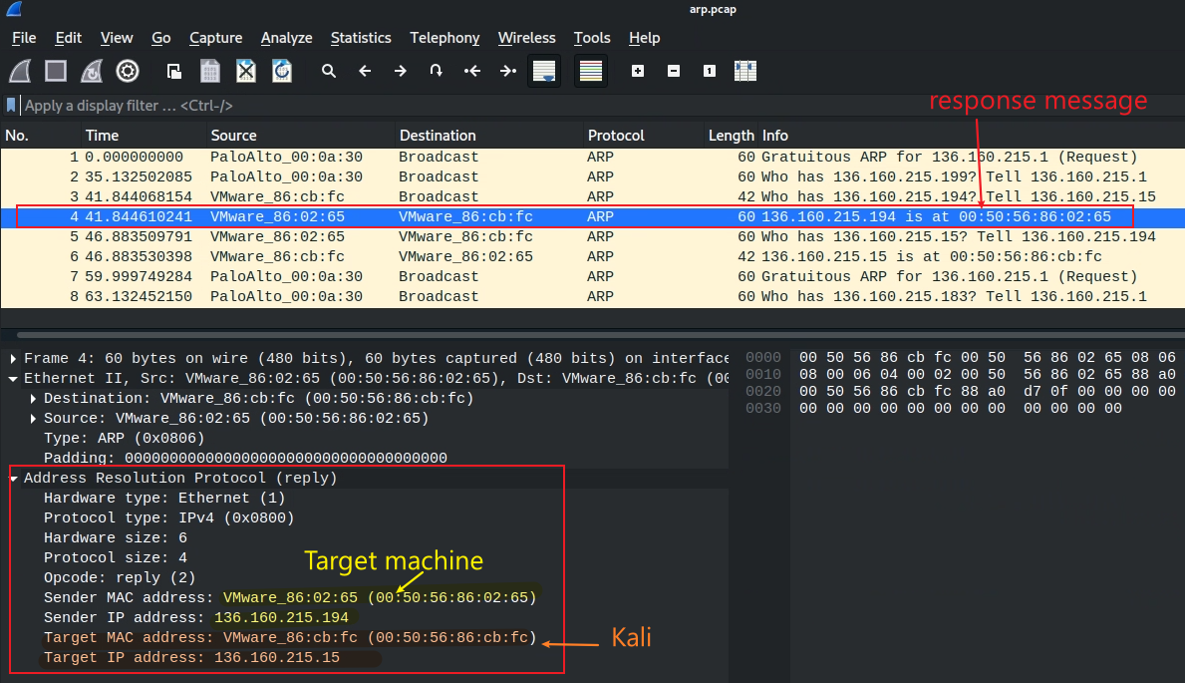

ARP reply message

Slide 19
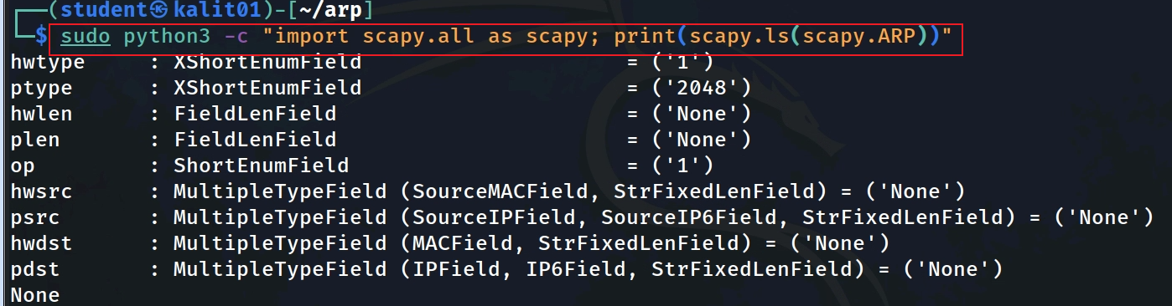






ARP fields in Python scapy library vs. in Wireshark
Notes:
sudo python3 -c "import scapy.all as scapy; print(scapy.ls(scapy.ARP))"

Slide 20
ARP poisoning

Slide 21
What is ARP Spoofing/Poisoning
A type of cyber attack where an attacker sends false Address Resolution Protocol (ARP) messages over a local area network (LAN).
By doing this, the attacker can associate their own MAC address with the IP address of another device on the network, allowing them to intercept or modify data that is intended for that device.
ARP Spoofing attacks can be used to conduct man-in-the-middle (MITM) attacks, steal sensitive information, or cause network disruption.
Prevent ARP Spoofing
network administrators can implement measures such as using ARP spoofing detection software, limiting the number of devices on the network, or using virtual LANs (VLANs).
Spoofing vs poisoning
spoofing = using other’s identity/IP
Poisoning = consequence of spoofing
Notes:
https://www.thepythoncode.com/article/building-arp-spoofer-using-scapy

Slide 22
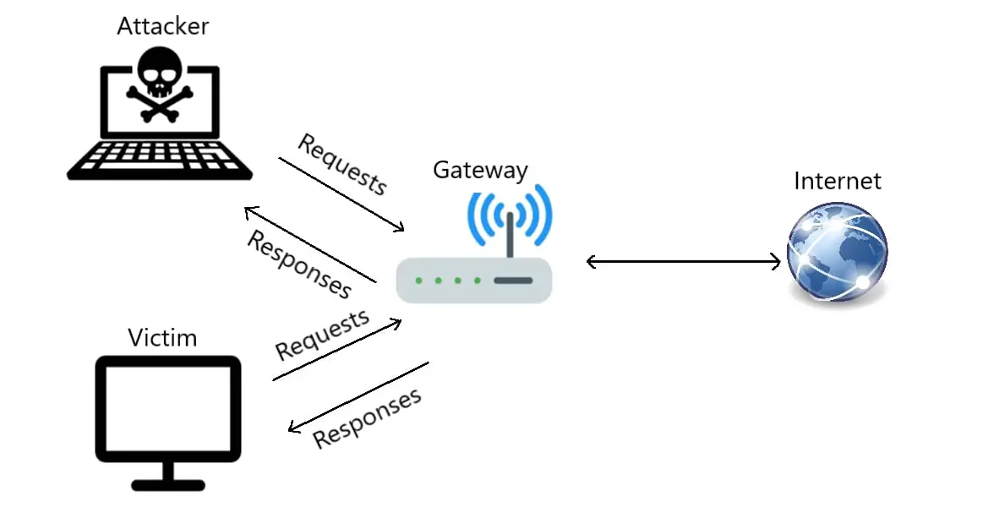
Before Attacking/ARP tables are clean
Gateway IP | Gateway Mac
Victim IP | Victim Mac
Gateway IP | Gateway Mac

Slide 23
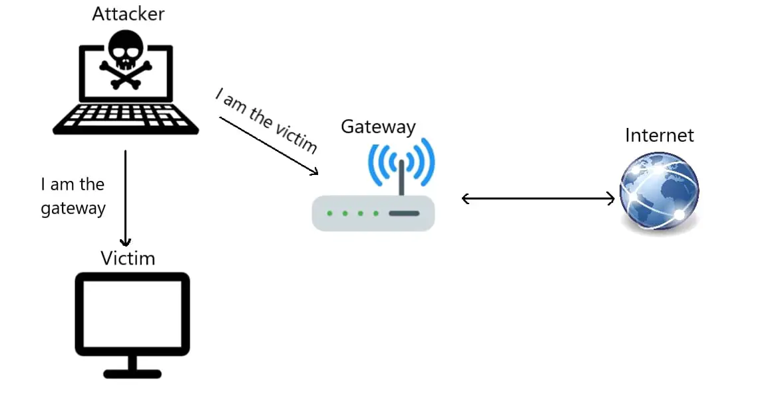
Attacking/Poisoning ARP tables
Security Problem: Anyone (Attacker) can send an ARP response message to anyone (Victim/Gateway) on the LAN without an ARP request to poison anyone’s (Victim/Gateway’s) ARP table
Security consequence: The Victim/Gateway will go to whatever IP the attacker injected into their ARP tables.
Sending ARP response to the gateway (target) saying that "I have the victim's IP address, use my MAC to talk".
Sending ARP response to the victim (target) saying that "I have the gateway's IP address, used my MAC to talk".

Slide 24
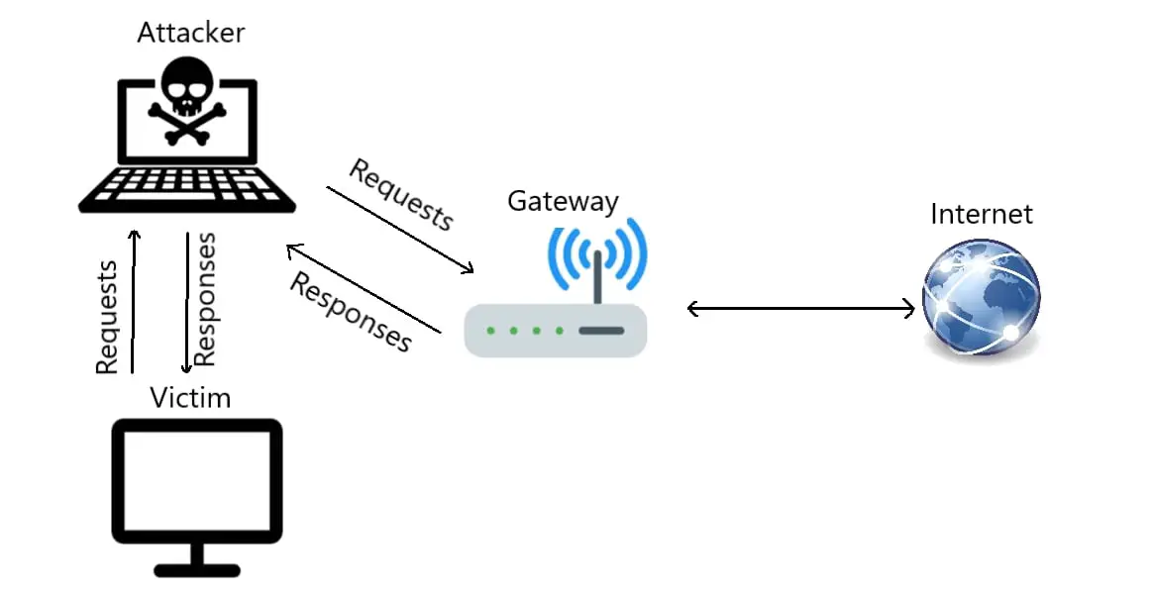
After Attack/ARP tables were poisoned
act as a middleman
Victim IP | Attack’s Mac
poisoned ARP
Gateway IP | Attack’s Mac
man-in-the-middle attack

Slide 25
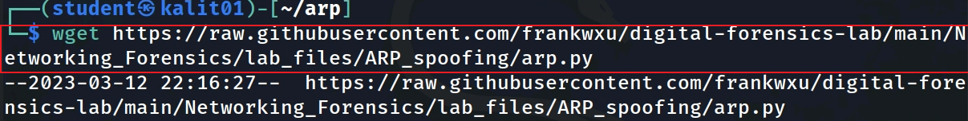
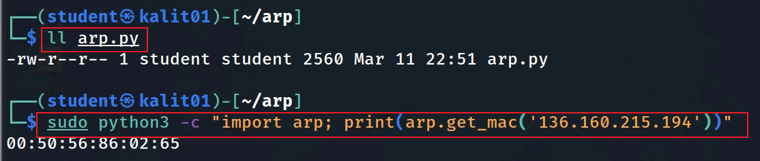
Download ARP poisoning attacking code
Download ARP attacking code from github
Get MAC address of a given IP
Notes:
https://raw.githubusercontent.com/frankwxu/digital-forensics-lab/main/Networking_Forensics/lab_files/ARP_spoofing/arp.py
sudo python3 -c "import arp; print(arp.get_mac('136.160.215.194'))"

Slide 26
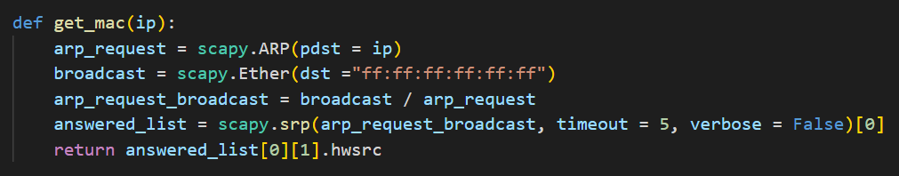
a Python function that uses the Scapy library to obtain the MAC address of a device on a local network given its IP address.
The function takes an IP address as its argument.
It creates an ARP (Address Resolution Protocol) request packet using Scapy's ARP function and sets the "pdst" field to the IP address provided as an argument.
It creates an Ethernet broadcast frame using Scapy's Ether function and sets the destination MAC address to "ff:ff:ff:ff:ff:ff". This frame is used to broadcast the ARP request packet to all devices on the network.
It combines the ARP request packet and the Ethernet broadcast frame into a single packet using Scapy's "/" operator.
It uses Scapy's srp function to send the combined packet to the network and receive a list of packets in response within a timeout period of 5 seconds. The "verbose" argument is set to False to suppress output.
The function returns the MAC address of the first device that responds to the ARP request. This is obtained from the "hwsrc" field of the second element of the first element in the list of responses.

Slide 27
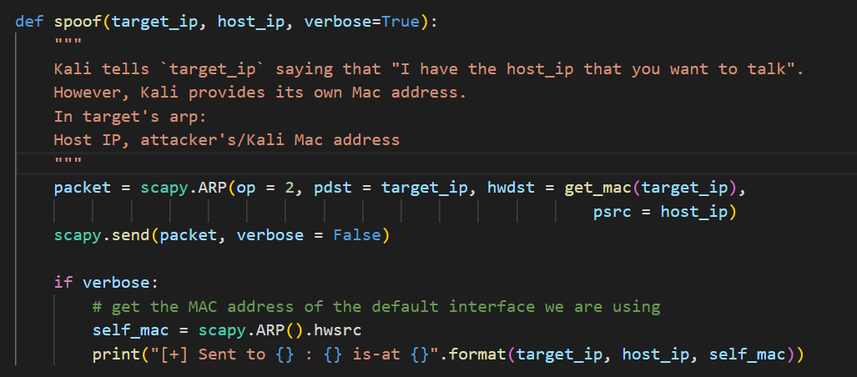
a Python function that performs an ARP spoofing attack on a target device on a local network.
The attacker’s/Kali’s MAC is automatically attached to the ARP response
The function takes two IP addresses as arguments - target_ip and host_ip.
target_ip is the IP address of the device whose ARP table we want to spoof, while
host_ip is the IP address of the device that the target device wants to communicate with.
It creates an ARP packet using Scapy's ARP function and sets the op field to 2 to indicate an ARP reply packet. The pdst field is set to target_ip, the IP address of the target device, and the hwdst field is set to the MAC address of the target device, obtained using the get_mac function. The psrc field is set to host_ip, the IP address of the device that the target wants to communicate with.
It sends the ARP packet using Scapy's send function, with the verbose argument set to False to suppress output.
If verbose is True, the function prints a message indicating that an ARP reply packet has been sent to the target device, along with the MAC address of the attacker's own interface.

Slide 28
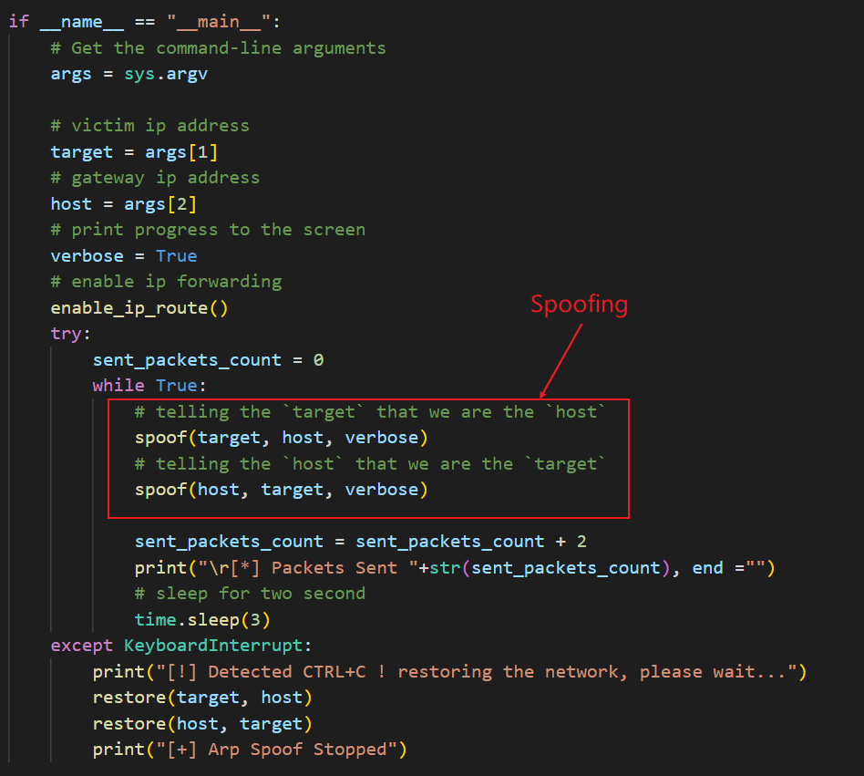

Slide 29
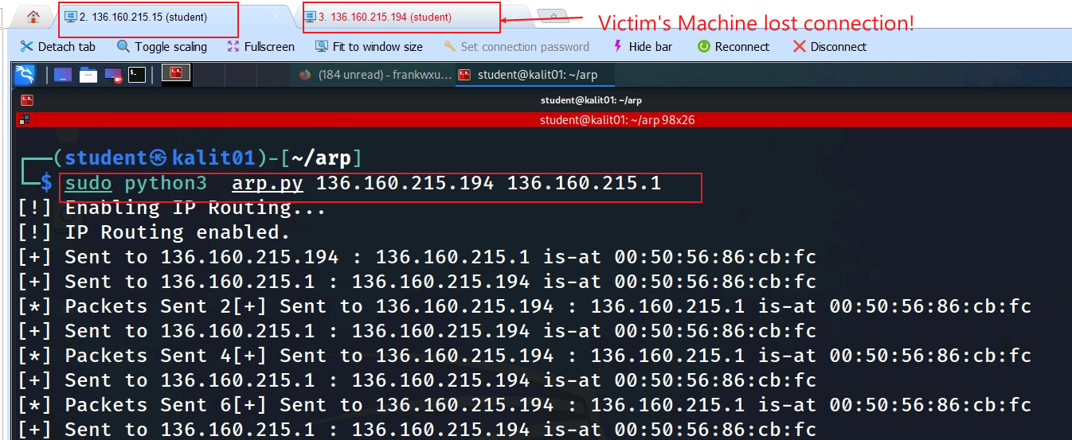
Launch ARP poisoning Attacking

Slide 30
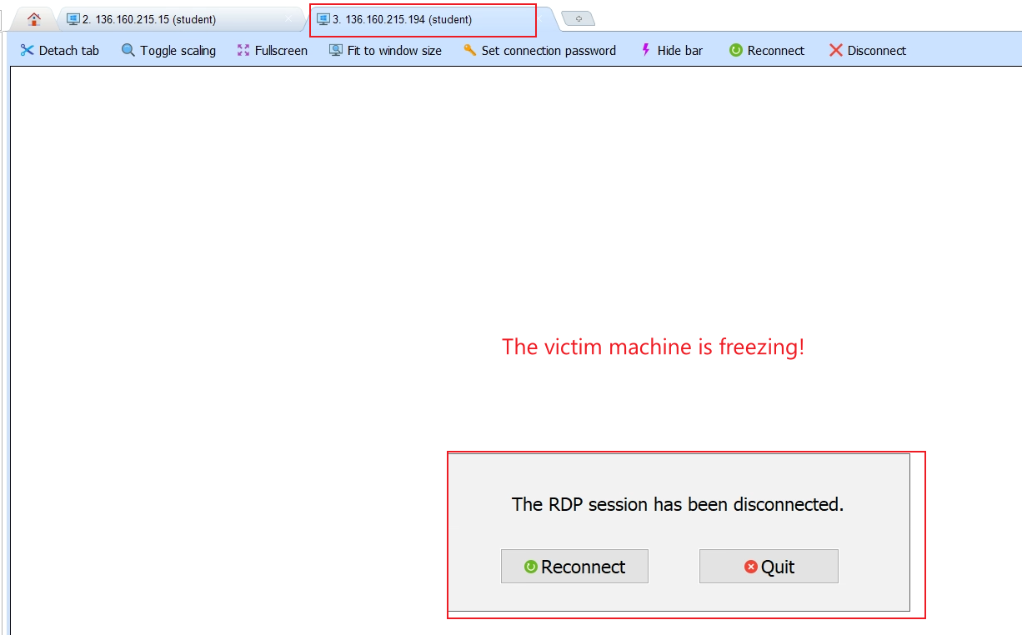

Slide 31
Capture and Analyze ARP Spoofing Traffic

Slide 32
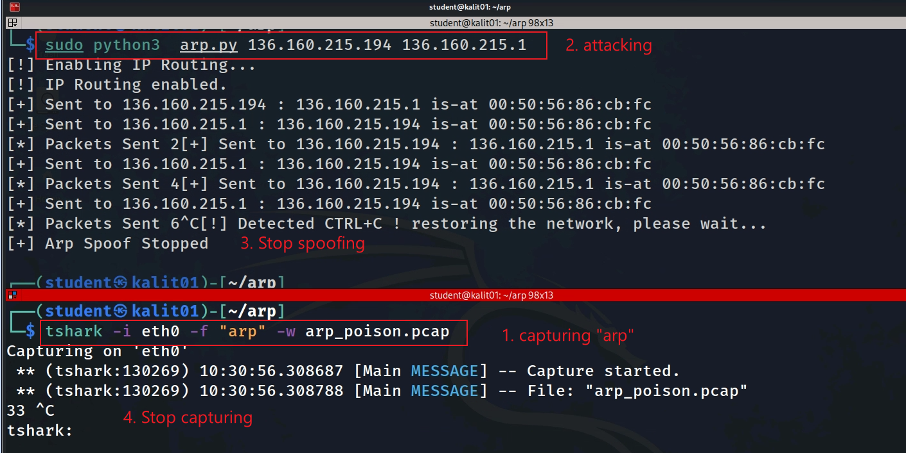
How to capture ARP spoofing traffic

Slide 33
Download traffic (Option)
wget https:/raw.githubusercontent.com/frankwxu/digital-forensics-lab/main/Networking_Forensics/lab_files/ARP_spoofing/arp.pcap

Slide 34
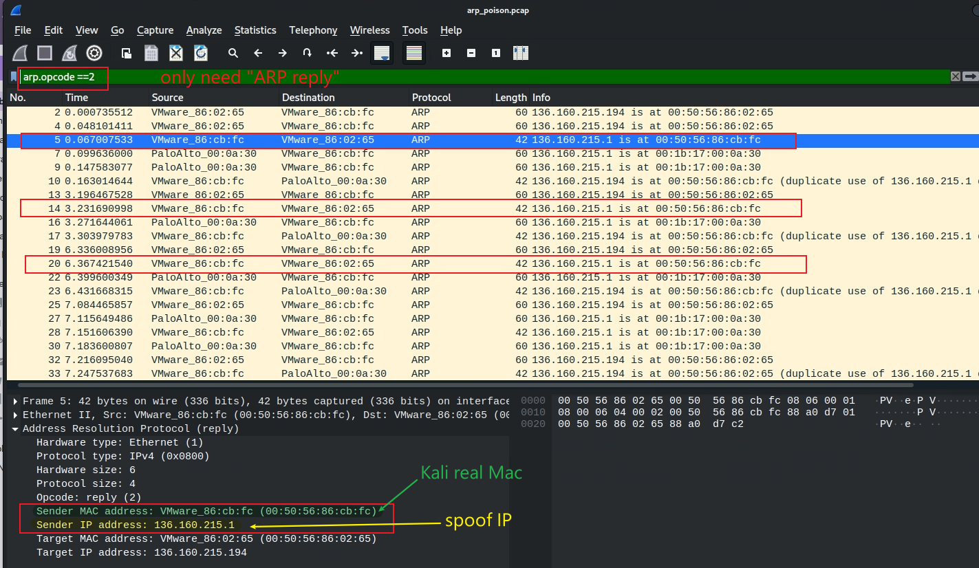

targeting Victim

Slide 35
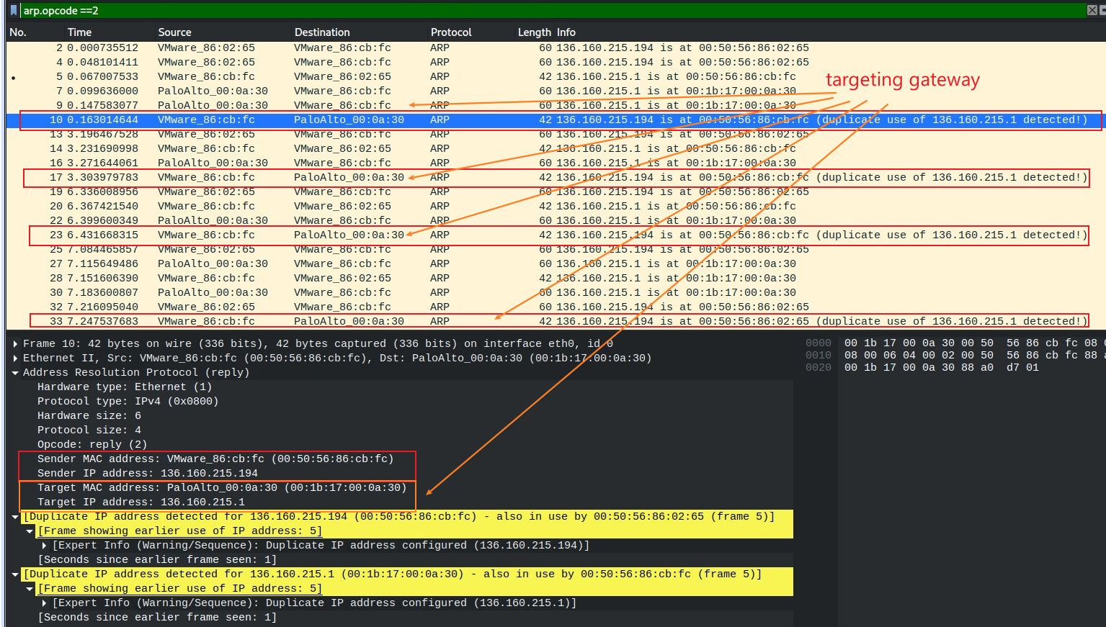

Slide 36
Conclusion
ARP spoofing attacker spoofs or falsifies the IP in ARP messages.
ARP spoofing is similar to identifying theft
Both ARP spoofing and identity theft involve a perpetrator deceiving the victim in order to gain access to sensitive information.
ARP messages to trick other devices on the network into sending traffic to the attacker's device instead of the legitimate device, allowing the attacker to intercept and steal sensitive information

Slide 37
Assignment
Repeat all slides
Use Kali and another machine to
capture ARP protocol
capture ARP spoofing
Show poisoned ARP table

